Slide 1
CH12 OS Security
Zonghua Gu
2017, ZJU
Notes:
This chapter provides an overview of computer security. We begin with a discussion
of what we mean by computer security. In essence, computer security deals
with computer-related assets that are subject to a variety of threats and for which
various measures are taken to protect those assets. Accordingly, the next section of
this chapter provides a brief overview of the categories of computer-related assets
that users and system managers wish to preserve and protect, and a look at the
various threats and attacks that can be made on those assets. Then, we survey the
measures that can be taken to deal with such threats and attacks. This we do from
three different viewpoints, in Sections 1.3 through 1.5. We then lay out in general
terms a computer security strategy.
The focus of this chapter, and indeed this book, is on three fundamental
questions:
1. What assets do we need to protect?
2. How are those assets threatened?
3. What can we do to counter those threats?

Slide 2
Outline
Understand the important role an Operating System (OS) plays in computer security
Learn about the need for hardware support for isolating OS from untrusted user/application code
Understand key Trusted Computing Base concepts

Slide 3
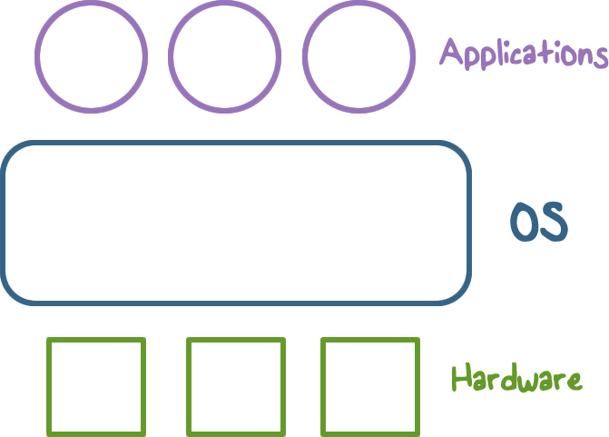
Operating System (OS)
An OS interacts with both applications and hardware.
It provides easier to use and high level abstractions for resources such as address space for memory and files for disk blocks.
Provides controlled access to hardware resources.
Provides isolation between different application processes , and between (untrusted) application processes running untrusted/application code and the (trusted) OS.
Notes:
A Computer system is hardware/OS/user applications
An operating system is interacts with both the applications and the Hardware. Operating system has direct access to hardware resources.
It provides easier to use and high level abstractions of these resources such as address space for memory and files for disk blocks.
Provides isolation between different processes and between the processes running untrusted/application code and the trusted operating system.

Slide 4
Need for Trusting an OS
The OS is a Trusted Computing Base (TCB). To be trusted, it must meet the following requirements:
Tamper-proof
Untrusted code in user space cannot tamper with it
Complete mediation
Every access to protected resources must go through and be mediated by it
Correct
Protected resources should be used in a correct way
Notes:
Why do we need to trust the operating system (it is also called a trusted computing base or TCB)
TCB Requirements: (1) Complete mediation, (2) Tamper-proof, and (3) Correct

Slide 5
TCB and Resource Protection
TCB controls access to protected resources
Must establish the source of a request for a resource through authentication
Authorization
Mechanisms that allow various access control policies to be supported
Notes:
or access control

Slide 6
Secure OS Quiz
A system call allows application code to gain access to functionality implemented by the OS. A system call is often called a protected procedure call. Is the cost of a system call:
the same as a user-level function call
higher than a user-level function call
ANS: B
A system call crosses the user-kernel boundary, hence is more expensive than a user-level function call

Slide 7
TCB Requirement 1
Tamper Proof

Slide 8
Isolating OS from Untrusted User Code
How do we meet the first requirement of a TCB (e.g., isolation or tamper-proof)?
Hardware support for memory protection (MMU)
Processor execution modes
system vs. user modes
some processors support more than two execution rings
Privileged instructions which can only be executed in system mode
e.g., those that access hardware directly
System calls used to transfer control between user and OS code
Notes:
How do we meet the requirements of a TCB (e.g., isolation or tamper-proof)?
Hardware support for memory protection
Processor execution modes (system AND user modes, execution rings)
Privileged instructions which can only be executed in system mode
System calls used to transfer control between user and system code

Slide 9
System Calls: Going from User to OS Code
System calls used to transfer control between user and system code
Such calls come through “call gates” and return back to user code. The processor execution mode or privilege ring changes when call and return happen.
x86 sysenter/sysexit instructions
Notes:
Such calls come through “call gates” and return back to user code. The processor execution mode or privilege ring changes when call and return happen.

Slide 10
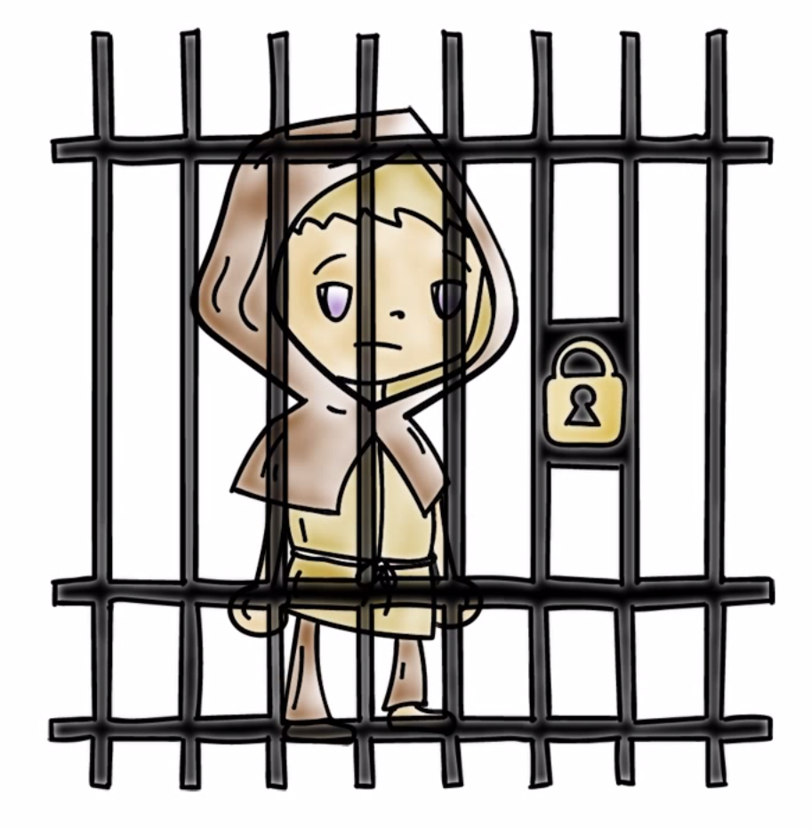
Isolating User Processes from Each Other
How do we meet the user/user isolation and separation?
OS uses memory protection to ensure this.
Notes:
How do we meet the isolation OS/user isolation and separation?
Hardware support for memory protection.

Slide 11
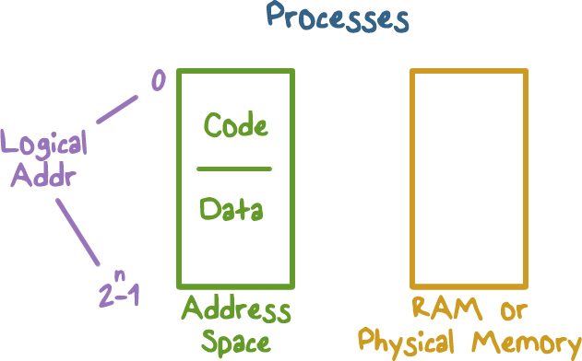
Address Space: Unit of Isolation
Each process views memory as a contiguous memory address space (often larger than available physical memory)
Each process has its own address space, with size 2³² (for 32-bit address) or 2⁶⁴ (for 64-bit address).
Notes:
Discuss the logical address mapping to the physical memory.
Every process views memory as contiguous, often larger than available physical memory.
Usually 2^32 or 2^64 addresses
Each process has its own mapping

Slide 12
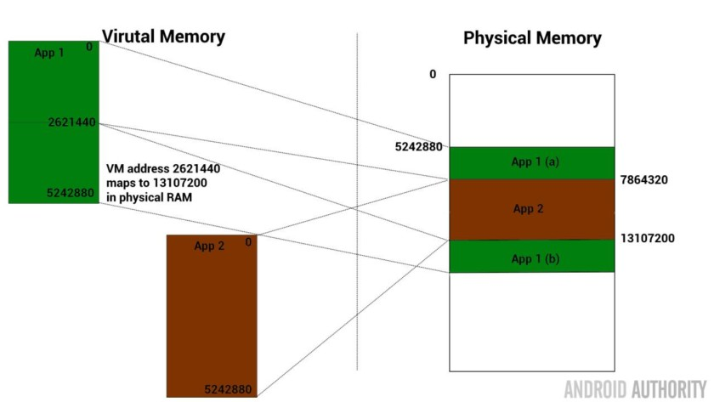
Process Data/Code Protection
The OS Page Table maps logical virtual memory addresses (pages) into physical memory addresses (pages)
Memory spaces of different processes are mapped to different parts of the physical memory
OS will not map a virtual page of one process to a physical page of another process (unless explicit sharing is desired)
App1 cannot access App2’s memory because it has no way to reach its memory

Slide 13
Hardware Support for Memory Management
The Page Table mechanism requires hardware support, the Processor’s Memory Management Unit (MMU)
RWX bits on physical memory pages limit type of access to addressable memory
R: Read; W: Write; X: eXecute
e.g., Malicious code injection and execution on the stack can be prevented by making the stack memory non-executable
Notes:
Processor memory management unit (MMU) uses page tables to resolve virtual addresses to physical addresses.
RWX bits on pages limit type of access to addressable memory

Slide 14
Revisiting Stack Overflow Quiz
The stack can be exploited through:
Overflowing the buffer to change the return address to alter program execution
Pushing data onto the stack to overflow the stack into the heap
Popping data off the stack to gain access to application code.
ANS: A
Notes:
QUIZ: Before we discuss how to create a non-executable stack, let’s discuss the stack’s exploitable weaknesses.
SOLUTION: Discuss answers

Slide 15
OS Isolation from Application Code
OS (Kernel) resides in a portion of each process’s address space.
True for each process, processes can cross the fence only in controlled/limited ways.
Notes:
Some more details for isolation of OS from application code.
OS (Kernel) resides in a portion of each process’s address space.
True for each process, processes can cross the fence only in controlled/limited ways.

Slide 16
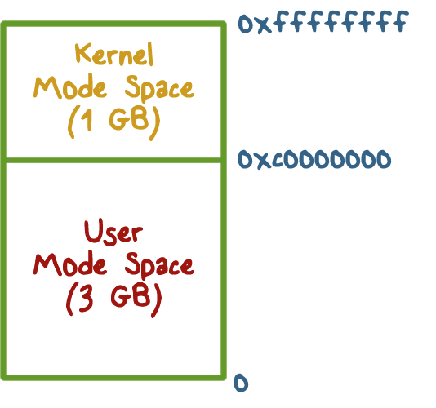
OS Isolation from Application Code
32-bit Linux: lower 3GB for user space, top 1GB for kernel space
Corresponds to x86 privilege ring transitions (ring0 for kernel space, ring3 for user space)
Windows and OS X similar
DOS, and small Real-Time Operating Systems, have no such fence, any process could alter the kernel
Notes:
32-bit Linux: Lower 3GB for process, top 1GB for kernel
Corresponds to x86 privilege ring transitions
Windows and OS X similar
DOS had no such fence, any process could alter DOS and viruses could spread by hooking DOS interrupt handlers via kernel changes

Slide 17
Execution Privilege Level Quiz
Which of the following functions should be executed in kernel space?
Switching CPU from one process to another when a process blocks. (scheduler)
Page fault handling
Changing who can access a protected resource such as a file
Setting up a new stack frame when an application program calls one of its functions
ANS: A, B, C

Slide 18
TCB Requirement 2
Complete Mediation

Slide 19
Complete Mediation:
The TCB
Make sure that no protected resource (e.g., memory page or file) could be accessed without going through the TCB
TCB acts as a reference monitor that cannot be bypassed
Privileged instructions
Notes:
Complete Mediation
Make sure that no protected resource (e.g., memory page or file) could be accessed without going through the TCB
TCB acts as a reference monitor that cannot be bypassed

Slide 20
Complete Mediation:
User Code
User code cannot access kernel space without issuing a system call and changing to system mode
User code cannot access physical resources directly because they require privileged instructions (e.g. servicing interrupts) which can only be executed in system mode
Notes:
User code cannot access OS part of address space without changing to system mode
User code cannot access physical resources because they require privileged instructions (e.g. servicing interrupts) which can only be executed in system mode

Slide 21
Secure OS Quiz #2
Complete mediation ensures that the OS cannot be bypassed when accessing a protected resource. How does the OS know who is making the request for the resource?
Process runs on behalf of a user who must have previously logged in,
Requested resource allows us to find out who must be requesting it.
ANS: A

Slide 22
Complete Mediation:
OS
To ensure complete mediation:
OS virtualizes physical resources and provides an API for virtualized resources, e.g., files for storing persistent data on disk
Virtual resource must be translated to physical resource handle (e.g., disk blocks), which can only be done by OS
Notes:
OS virtualizes physical resources and provides an API for the virtualized resources
File for storing persistent data on disk
Virtual resource must be translated to physical resource handle (e.g., file buffers) which can only be done by OS, which ensures complete mediation

Slide 23
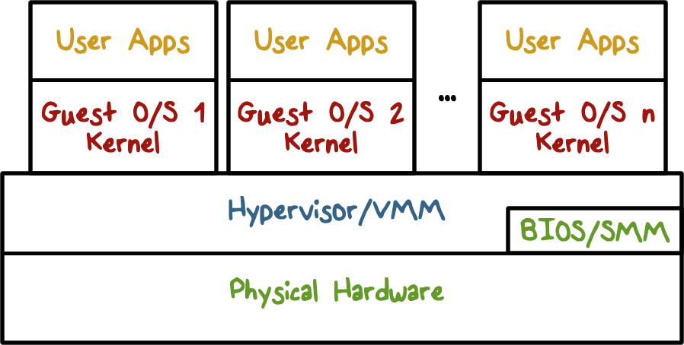
Virtualization
OS is large and complex; compromise of an OS impacts all applications
With virtualization: a Hypervisor (Virtual Machine Monitor) enforces isolation between Virtual Machines (VMs) that run guest OSes and applications
Compromise of OS in VM1 only impacts applications running on VM1
The TCB is the Hypervisor
Notes:
Virtualization is used in Cloud computing systems. Let us discuss some security aspects of it.
OS is large and complex, even different operating systems may be desired by different customers
Compromise of an OS impacts all applicationsCan we limit/contain harm done by OS running some application?
Hypervisor, virtual machines, guest OS and applications
Compromise of OS in VM1 only impacts applications running on VM2

Slide 24
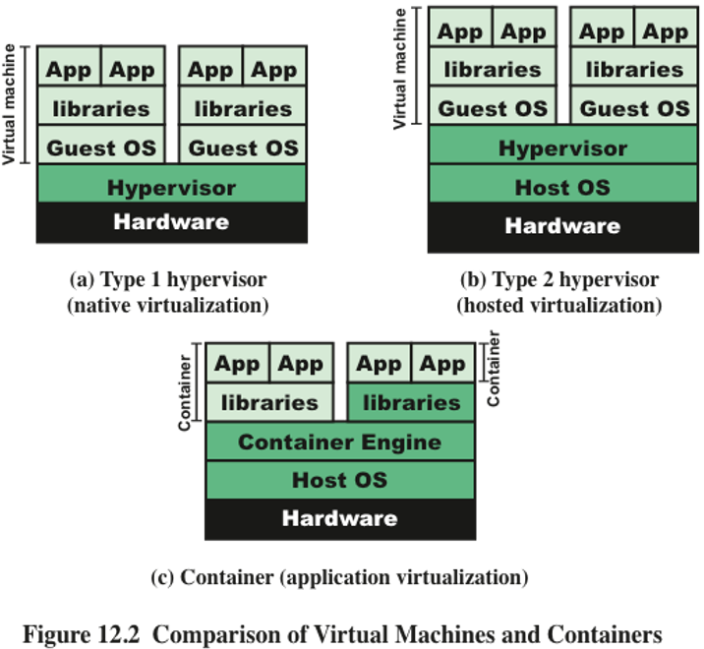
Types of Virtualization
Type 1 hypervisor runs directly on top of hardware; also called bare-metal hypervisor or native virtualization.
XEN
Type 2 hypervisor runs on top of a host OS; also called hosted hypervisor or hosted virtualization.
KVM, VMWare, VirtualBox
Container runs on top of a host OS as a process; also called process or application virtualization. Lightweight but less secure than Type 1 or 2 hypervisor.
Docker

Slide 25
TCB Requirement 3
Correctness

Slide 26
Correctness
Compromise of TCB means an attacker has access to everything. Hence correctness of TCB is extremely important
Secure coding is important,
OS or hypervisor is typically written in languages that are not type safe (e.g., C)
Hypervisor is smaller and simpler than OS, hence easier to ensure correctness
Hypervisor is only responsible for partitioning physical resources among VMs
Notes:
orrectness – Final Requirement of TCB
Compromise of OS (TCB) means all bets are off, attacker has access to everything.
Getting the TCB is extremely important
Smaller and simpler (hypervisor only partitions physical resources among VMs and let us guest OS handle management)
Secure coding is really important when writing the OS which typically is written in languages that are not type safe
We will talk more about trustworthiness of TCB

Slide 27
TCB Requirements Quiz
What TCB requirement is violated as a result of an attack that exploits a vulnerability in an OS turns off the check that is performed before access to a protected resource is granted.
Complete mediation
Correctness
Tamper-proof
ANS: A, C

Slide 28
Summary
Understand the important role an OS plays in protecting resources and applications
Understand how OS is isolated from untrusted code with hardware support for memory management
Understand how complete mediation is provided.

